Slide 1
Floyd’s Algorithm for the All-Pairs Shortest-Paths Problem
the all-pairs shortest-paths problem asks to find the distances―i.e., the lengths of the shortest paths―from each vertex to all other vertices

Slide 2
Ex:
5
B
C
4
1
2
9
A

Slide 3
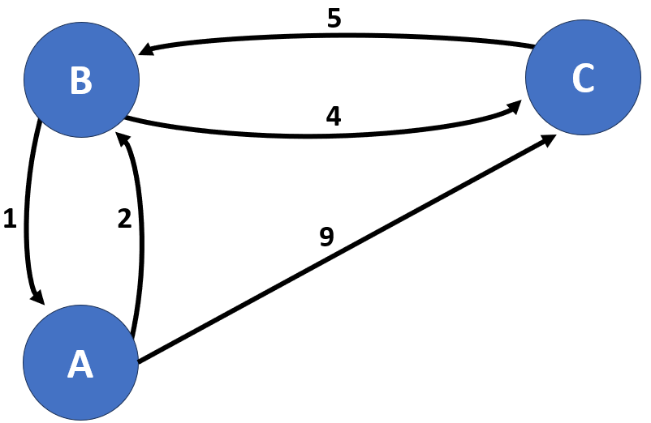
Ex:
 | A | B | C
A | 0 | 2 | 9
B | 1 | 0 | 4
C | ∞ | 5 | 0
 | A | B | C
A | 0 | 2 | 6
B | 1 | 0 | 4
C | 6 | 5 | 0
W
(weight matrix)
D
(distance matrix)

Slide 4
Ex:
 | A | B | C
A | 0 | 2 | 6
B | 1 | 0 | 4
C | 6 | 5 | 0
 | A | B | C
A | 0 | 2 | 9
B | 1 | 0 | 4
C | ∞ | 5 | 0
W
(weight matrix)
D
(distance matrix)
D(0) == W
D(1) put vertices (A) in the middle of any path
 | A | B | C
A | 0 | 2 | 9
B | 1 | 0 | 4
C | ∞ | 5 | 0
 | A | B | C
A | 0
B |  | 0
C |  |  | 0
 | A | B | C
A | 0 | 2 | 9
B | 1 | 0
C | ∞ |  | 0
 | A | B | C
A | 0 | 2 | 9
B | 1 | 0 | 4
C | ∞ | 5 | 0

Slide 5
Ex:
 | A | B | C
A | 0 | 2 | 6
B | 1 | 0 | 4
C | 6 | 5 | 0
 | A | B | C
A | 0 | 2 | 9
B | 1 | 0 | 4
C | ∞ | 5 | 0
W
(weight matrix)
D
(distance matrix)
D(1) put vertices (A) in the middle of any path
D(1) (A) in the middle of any path
D(2) put vertices (B) in the middle of any path
D(0) == W
 | A | B | C
A | 0 | 2 | 9
B | 3 | 0 | 4
C | ∞ | 5 | 0
 | A | B | C
A | 0 | 2 | 9
B | 3 | 0 | 4
C | ∞ | 5 | 0
 | A | B | C
A | 0 | 2 | 6
B | 1 | 0 | 4
C | 6 | 5 | 0
 | A | B | C
A | 0 | 2 | 9
B | 1 | 0 | 4
C | ∞ | 5 | 0
 | A | B | C
A | 0
B |  | 0
C |  |  | 0
 | A | B | C
A | 0
B |  | 0
C |  |  | 0
 | A | B | C
A | 0 | 2 | 9
B | 3 | 0
C | ∞ |  | 0
 | A | B | C
A | 0 | 2
B | 1 | 0 | 4
C |  | 5 | 0

Slide 6
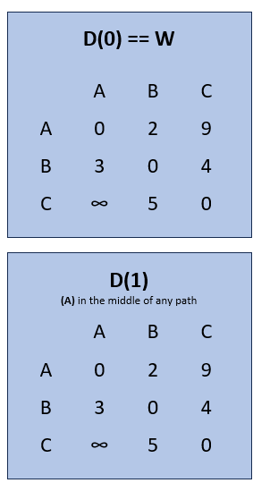


Ex:
 | A | B | C
A | 0 | 2 | 6
B | 1 | 0 | 4
C | 6 | 5 | 0
D
(distance matrix)
D(2) (B) in the middle of any path
D(3) put vertices (C) in the middle of any path
 | A | B | C
A | 0 | 2 | 6
B | 1 | 0 | 4
C | 6 | 5 | 0
 | A | B | C
A | 0
B |  | 0
C |  |  | 0
 | A | B | C
A | 0 |  | 6
B |  | 0 | 4
C | 6 | 5 | 0
 | A | B | C
A | 0 | 2 | 6
B | 1 | 0 | 4
C | 6 | 5 | 0

Slide 7
Ex:
 | A | B | C
A | 0 | 2 | 9
B | 1 | 0 | 4
C | ∞ | 5 | 0
 | A | B | C
A | 0 | 2 | 6
B | 3 | 0 | 4
C | 7 | 5 | 0
W
(weight matrix)
D
(distance matrix)
D(0) == W
D(1) (A) in the middle of any path
D(2) (B) in the middle of any path
D(3) (C) in the middle of any path
 | A | B | C
A | 0 | 2 | 9
B | 1 | 0 | 4
C | ∞ | 5 | 0
 | A | B | C
A | 0 | 2 | 9
B | 1 | 0 | 4
C | ∞ | 5 | 0
 | A | B | C
A | 0 | 2 | 6
B | 1 | 0 | 4
C | 6 | 5 | 0
 | A | B | C
A | 0 | 2 | 6
B | 1 | 0 | 4
C | 6 | 5 | 0

Slide 8


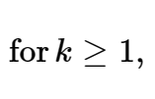


Ex:
So, What is the recurrence?
D(0) == W
D(1) (A) in the middle of any path
D(2) (B) in the middle of any path
D(3) (C) in the middle of any path
 | A | B | C
A | 0 | 2 | 9
B | 1 | 0 | 4
C | ∞ | 5 | 0
 | A | B | C
A | 0 | 2 | 9
B | 1 | 0 | 4
C | ∞ | 5 | 0
 | A | B | C
A | 0 | 2 | 6
B | 1 | 0 | 4
C | 6 | 5 | 0
 | A | B | C
A | 0 | 2 | 6
B | 1 | 0 | 4
C | 6 | 5 | 0

Slide 9
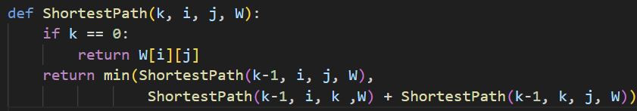
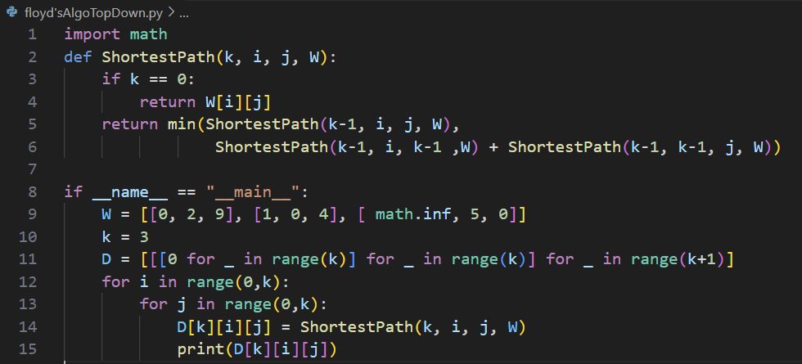
Ex:
3^n!!
And with the two loops n^2*3^n
D(0) == W
D(1) (A) in the middle of any path
D(2) (B) in the middle of any path
D(3) (C) in the middle of any path
 | A | B | C
A | 0 | 2 | 9
B | 1 | 0 | 4
C | ∞ | 5 | 0
 | A | B | C
A | 0 | 2 | 9
B | 1 | 0 | 4
C | ∞ | 5 | 0
 | A | B | C
A | 0 | 2 | 6
B | 1 | 0 | 4
C | 6 | 5 | 0
 | A | B | C
A | 0 | 2 | 6
B | 1 | 0 | 4
C | 6 | 5 | 0

Slide 10
Ex:
D(0) == W
D(1) (A) in the middle of any path
D(2) (B) in the middle of any path
D(3) (C) in the middle of any path
 | A | B | C
A | 0 | 2 | 9
B | 1 | 0 | 4
C | ∞ | 5 | 0
 | A | B | C
A
B
C
 | A | B | C
A
B
C
 | A | B | C
A |  |  | 6
B
C

Slide 11
Ex:
D(0) == W
D(1) (A) in the middle of any path
D(2) (B) in the middle of any path
D(3) (C) in the middle of any path
 | A | B | C
A | 0 | 2 | 9
B | 1 | 0 | 4
C | ∞ | 5 | 0
 | A | B | C
A
B
C
 | A | B | C
A
B
C
 | A | B | C
A |  |  | 6
B
C

Slide 12
And for all n x n matrix: for only 3 nodes, 243 calls

Slide 13
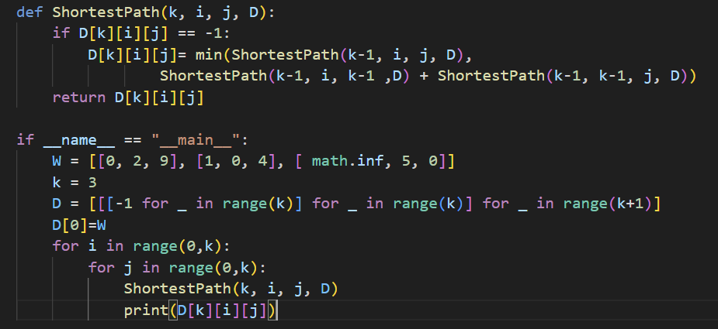
Dynamic Programing
Divide the problem into simpler subproblems and reuse the results of these subproblems
Careful brute force

Slide 14
Ex:
theta
N^3
D(0) == W
D(1) (A) in the middle of any path
D(2) (B) in the middle of any path
D(3) (C) in the middle of any path
 | A | B | C
A | 0 | 2 | 9
B | 1 | 0 | 4
C | ∞ | 5 | 0
 | A | B | C
A | 0 | 2 | 9
B | 1 | 0 | 4
C | ∞ | 5 | 0
 | A | B | C
A | 0 | 2 | 6
B | 1 | 0 | 4
C | 6 | 5 | 0
 | A | B | C
A | 0 | 2 | 6
B | 1 | 0 | 4
C | 6 | 5 | 0

Slide 15
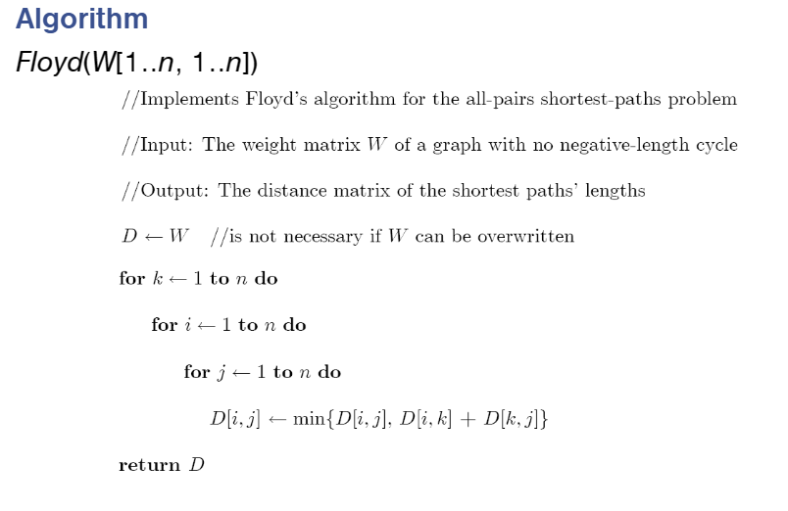

Slide 16
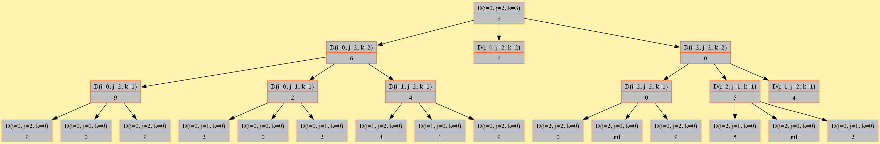
Ex:
D(0) == W
D(1) (A) in the middle of any path
D(2) (B) in the middle of any path
D(3) (C) in the middle of any path
 | A | B | C
A | 0 | 2 | 9
B | 1 | 0 | 4
C | ∞ | 5 | 0
 | A | B | C
A
B
C
 | A | B | C
A
B
C
 | A | B | C
A |  |  | 6
B
C

Slide 17
Ex:
D(0) == W
D(1) (A) in the middle of any path
D(2) (B) in the middle of any path
D(3) (C) in the middle of any path
 | A | B | C
A | 0 | 2 | 9
B | 1 | 0 | 4
C | ∞ | 5 | 0
 | A | B | C
A
B
C
 | A | B | C
A
B
C
 | A | B | C
A |  |  | 6
B
C

Slide 19

Small adjustment for the code to work :

